Slide 1
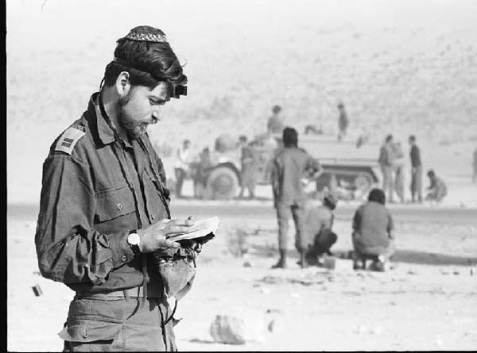
The Yom Kippur War

Slide 2
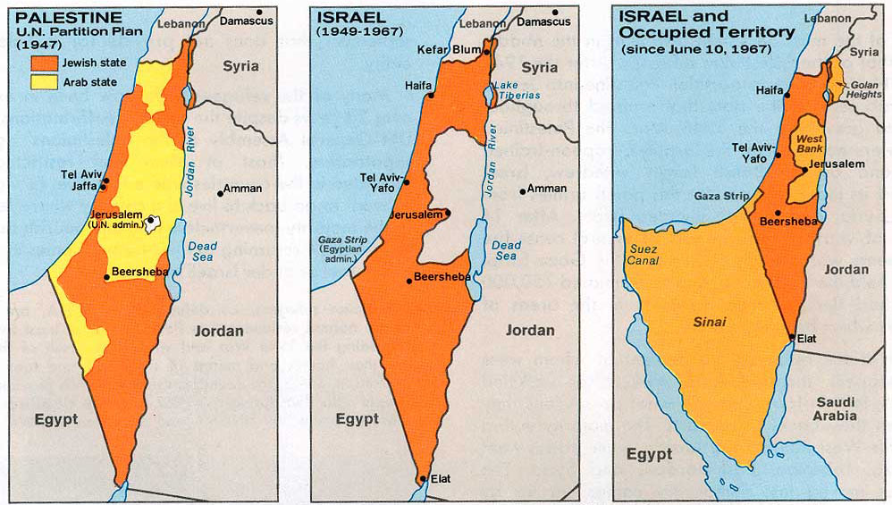
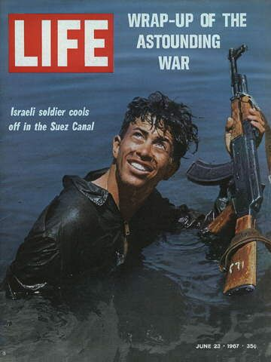
Background
1948 – 1st Arab-Israeli War after ISR independence
1956 – Suez Crisis
1967 – Six Day War
Israel takes over Sinai, Golan Heights, W. Bank, Gaza

Slide 3
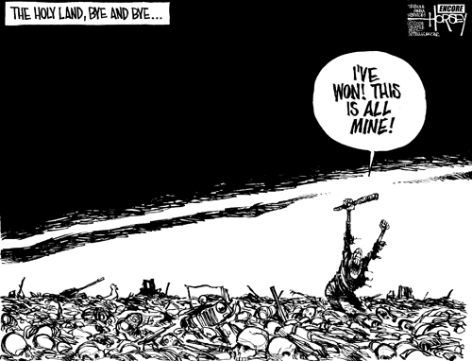
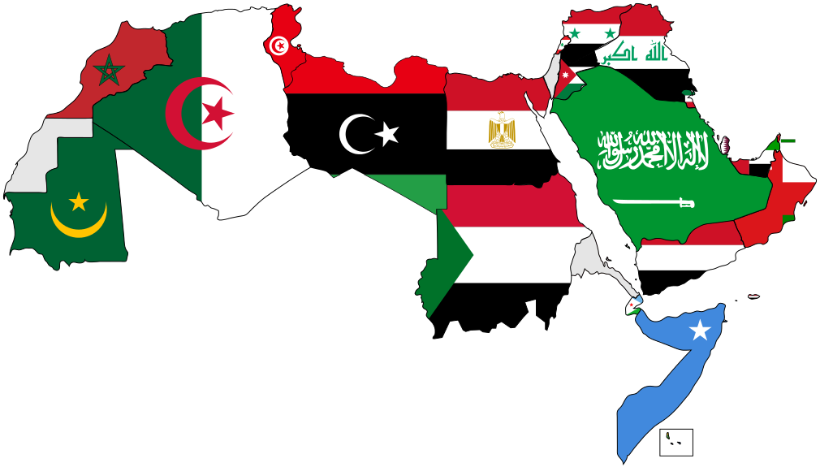
Why the Arab World is Important
Trade Routes at Suez & Gibraltar
Center of the world’s 2nd largest religion
A small percentage of Arabs control a large percentage of the world’s oil.

Slide 4
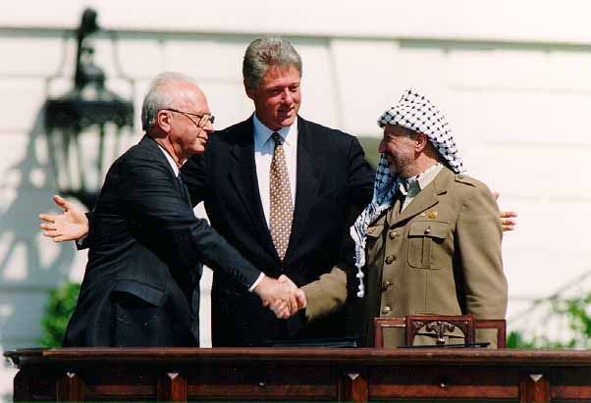
Why Israel is Important
ISR has no oil, population, geographic or strategic advantages & is surrounded by enemies
Driven army w/ high morale (IDF)
High level of education
“Moral Claim”
Supported by US Jews politically & economically

Slide 5
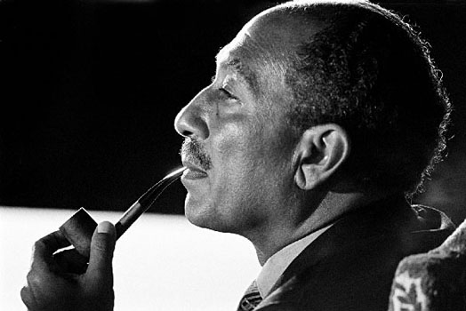
A New Start?
1970 – Nasser dies and Anwar Sadat takes over EGY w/ plan to reestablish US relations
Thought US could get ISR out of Sinai better than USSR
1972 – Expels 20K USSR troops→ show US he means business→
1973 – Sends Ismail to DC→ After no help, Sadat reluctantly goes back to USSR
AMBROSE: US did not care b/c they didn’t trust his intentions & were worried about EGY attacking ISR

Slide 6
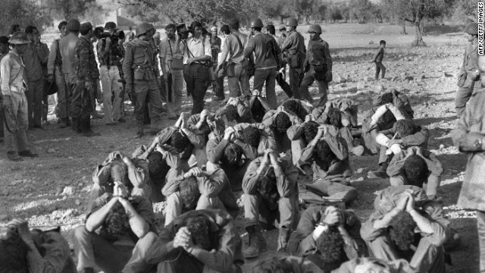
Yom Kippur
10/6/1973 – EGY surprise attacks ISR
EGY drove deep into Sinai
ISR as a nation was threatened→ Needed US help

Slide 7

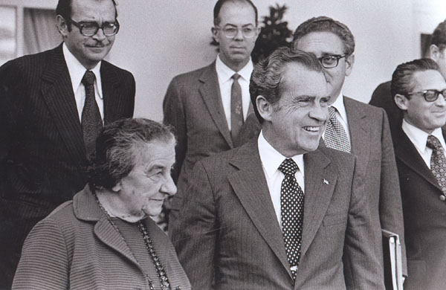
Henry Kissinger
Quotes on 261; YKW barely addressed by Kissinger.
Challenge: Had to save ISR while avoiding OPEC oil embargo and bring peace to the Middle East
Proposes ceasefire, but neither side would accept because they were losing (ISR) or not winning enough (EGY)
US Congress/Public thought ISR the victim
Soviets made it worse by shipping arms after promising not to→ AMBROSE: Challenge to US

Slide 8
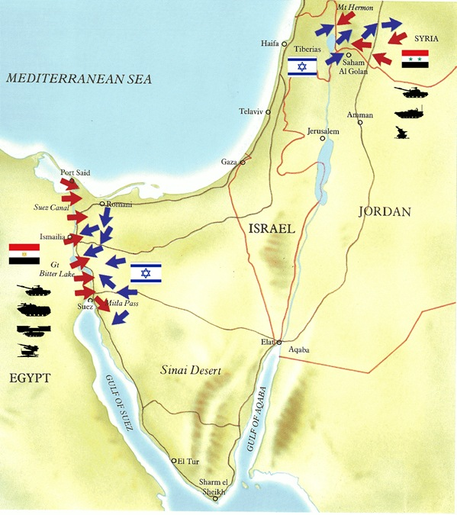
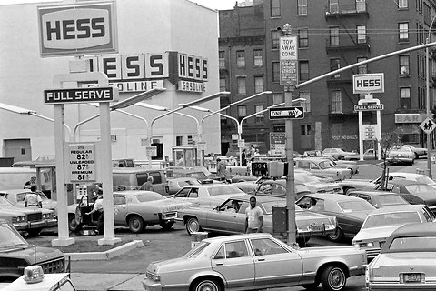
Kissinger Picks Israel
AMBROSE: Kissinger gives in to pressure b/c Russian guns should never prevail over US guns.
Military aid on 10/13→ Encirclement of EGY army & SYR to Golan Hts. by 10/15
Arab Response: Great Oil Embargo of 1973
AMBROSE: We never thought they’d stick together; We need them more than they need us

Slide 9
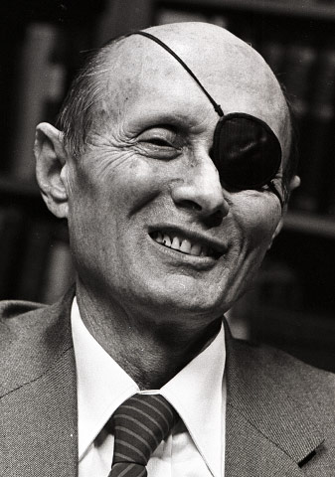
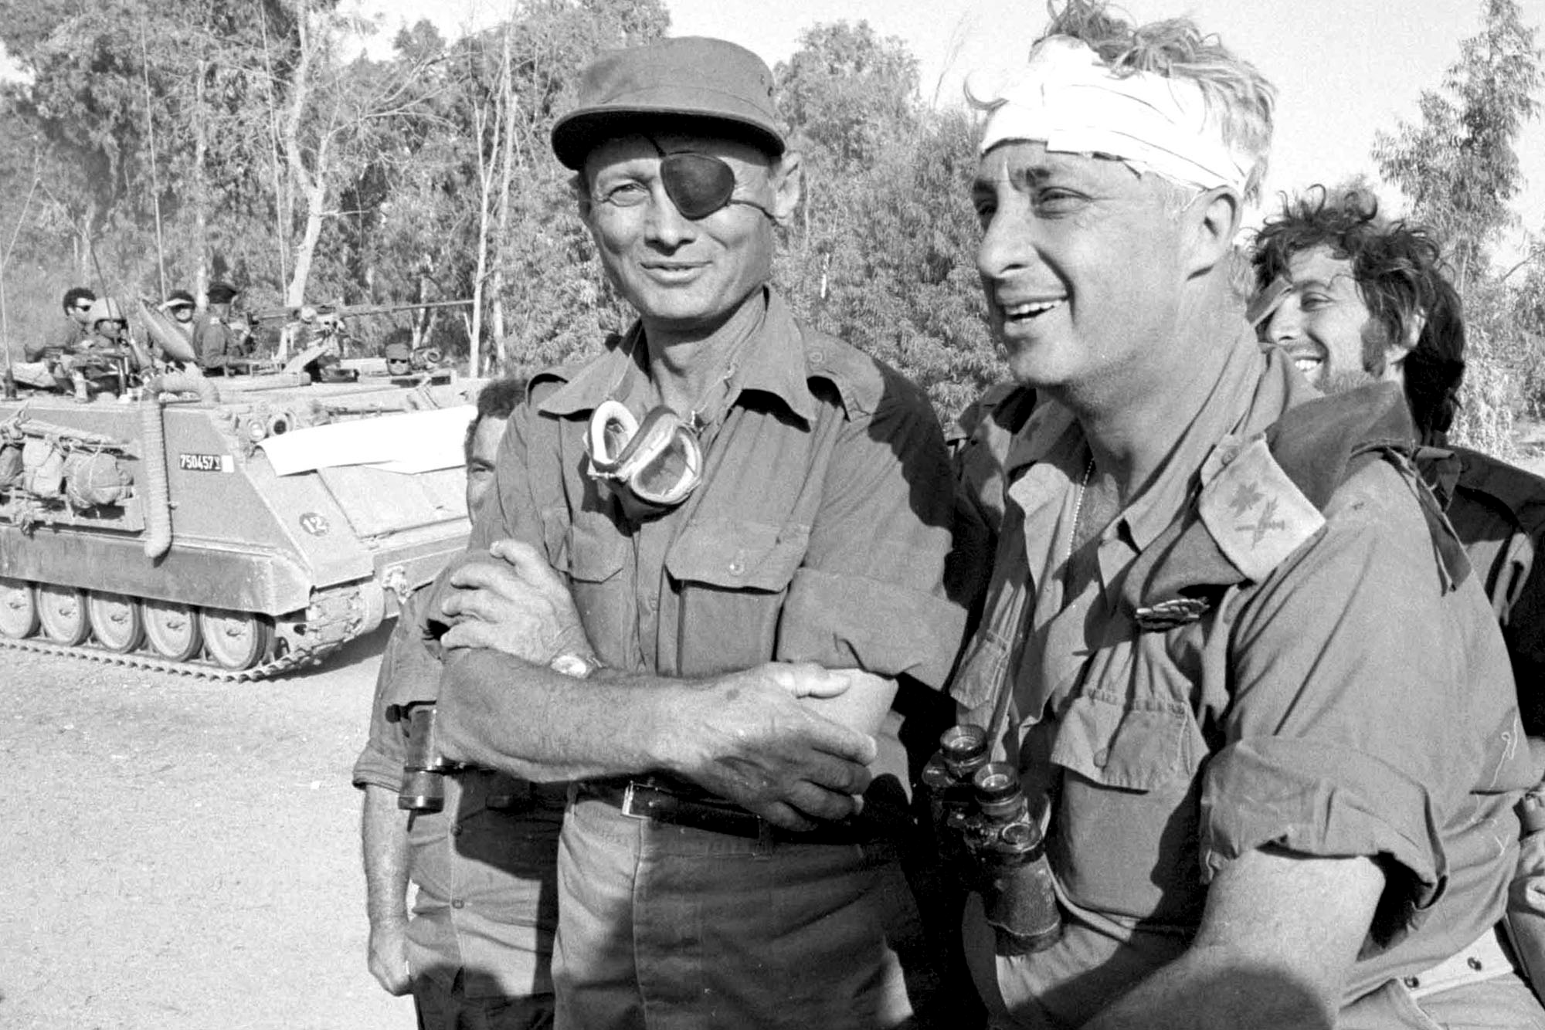
WWIII? No.
10/22 – UNSC-338 – Kiss. (through UN) & USSR call for ceasefire & implementation of UNSC-242
Moshe Dayan (IDF) – Clashed w/ Kissinger b/c of delicate oil situation→ angry
Brezhnev suggests US/USSR force to stop Dayan→
Kissinger’s “Deliberate Overreaction” (264) resulted in Brezhnev agreeing to non-nuclear UN Peacekeepers
Brezhnev agreed→ Dayan ended pressure→ War ends.

Slide 10
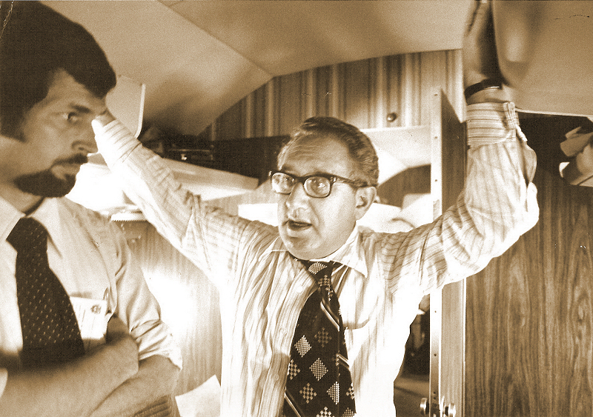
Shuttle Diplomacy
Kissinger’s attempt to bargain w/ heads of state in ME→ Didn’t achieve much except calls to compromise for both
1/18/74 – Egyptian-Israeli Accord – Mutual disengagement & pullback of forces along Suez + UN protection for buffer zone
3/18 – Embargo lifted
May ’74 – Ceasefire signed→ troops leave Golan

Slide 11
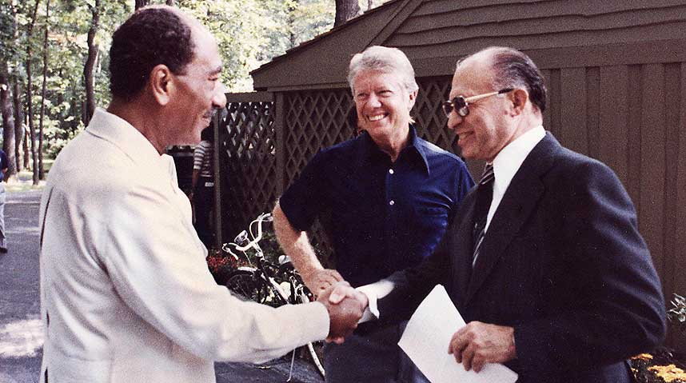
Aftermath
1977 – Kissinger leaves office
ISR still occupies most of Sinai, Palestinian territory
Fall ’78 – Carter meets w/ Sadat & Menachem Begin @ Camp David→ no peace treaty
Early ’79 – Meet again & sign a treaty…

Slide 12
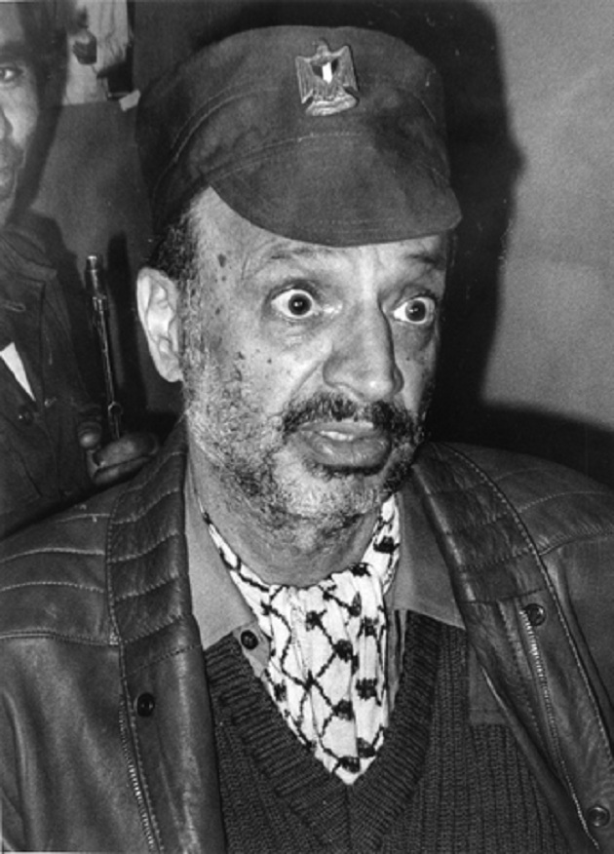
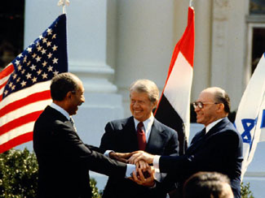
Camp David Accords
Egypt recognizes Israel; Peace
Israel leaves Sinai
Future of PLO vague
No mention of Golan Heights or Jerusalem
Nobel Peace Prizes all around!
Seriously!
What about ME?
- YA

Slide 13
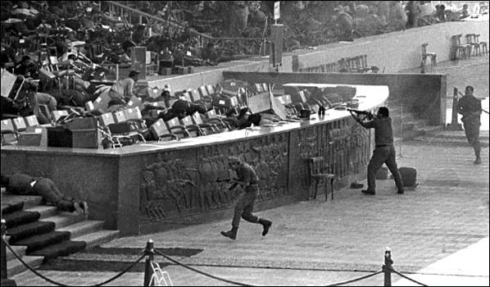
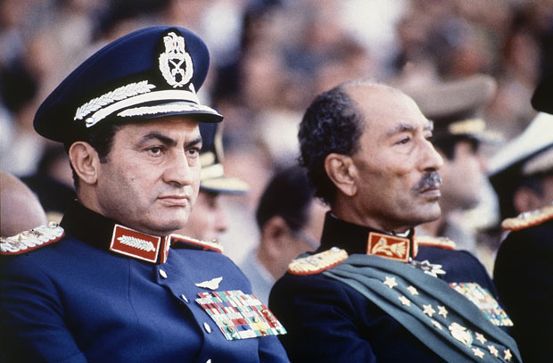
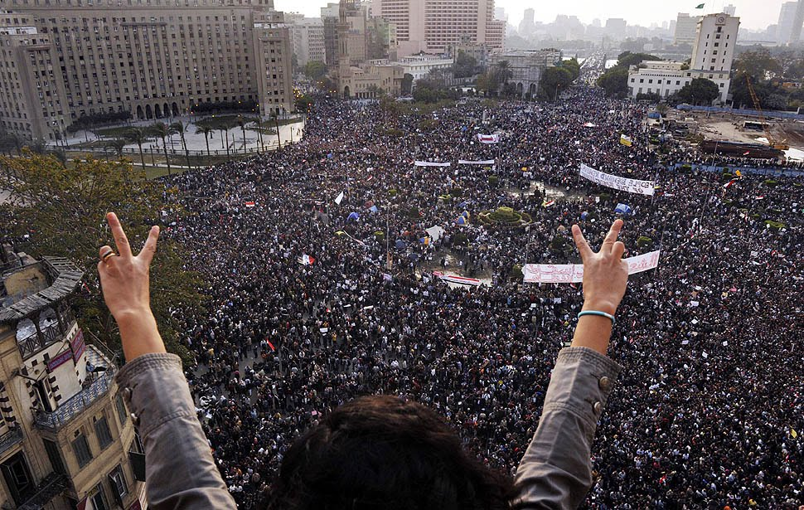
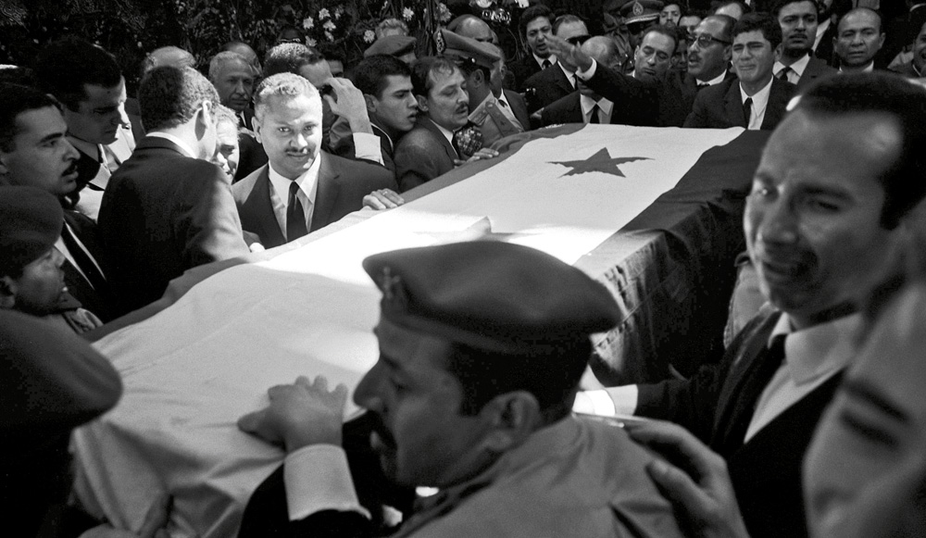
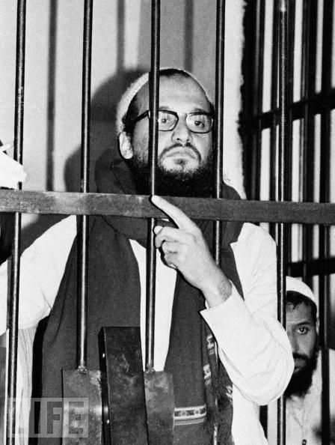
In the Arab World…
Arab states denounced Sadat even though ISR left Sinai by 1982.
Sadat assassinated by his own troops in 1981
VP Hosni Mubarak takes over until 2011

